Slide 1

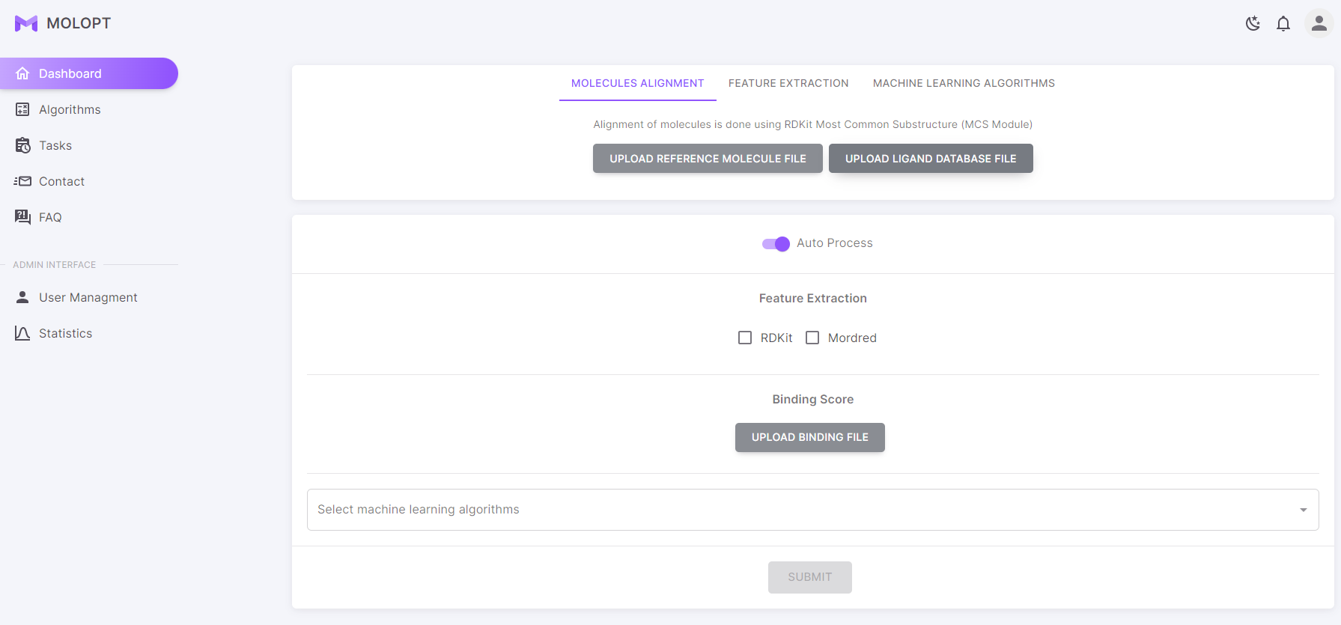
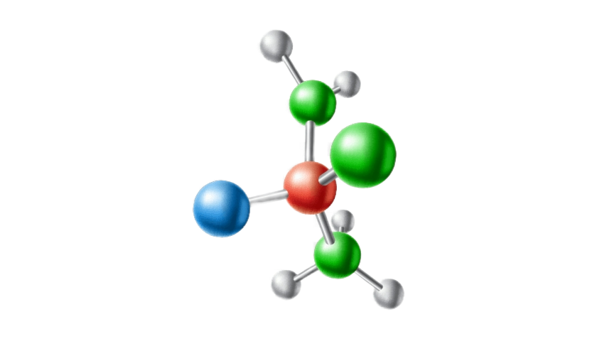
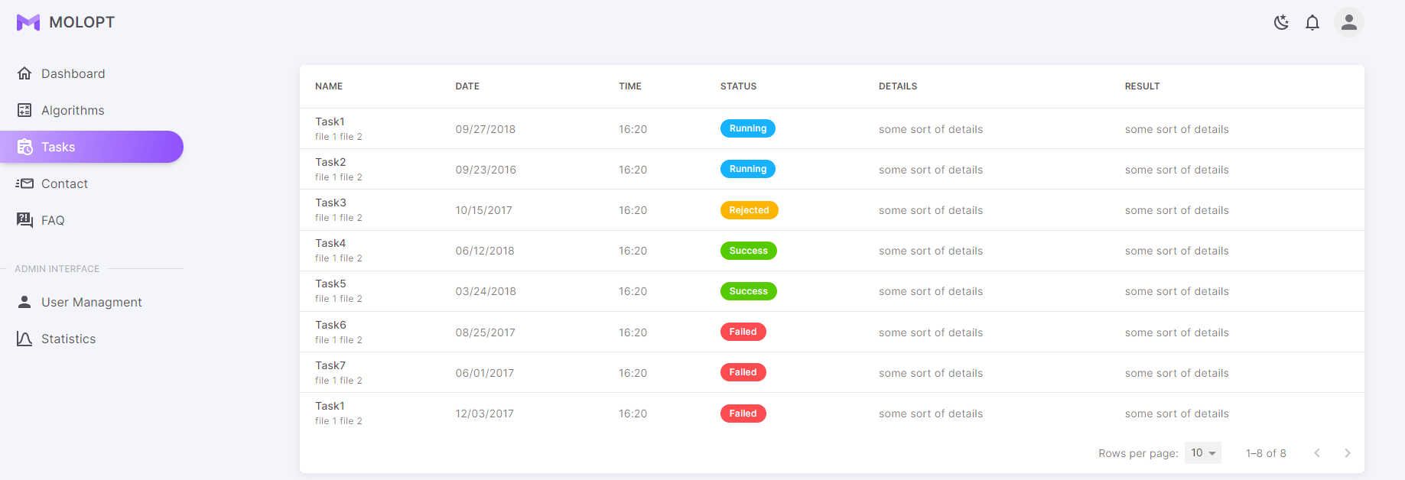
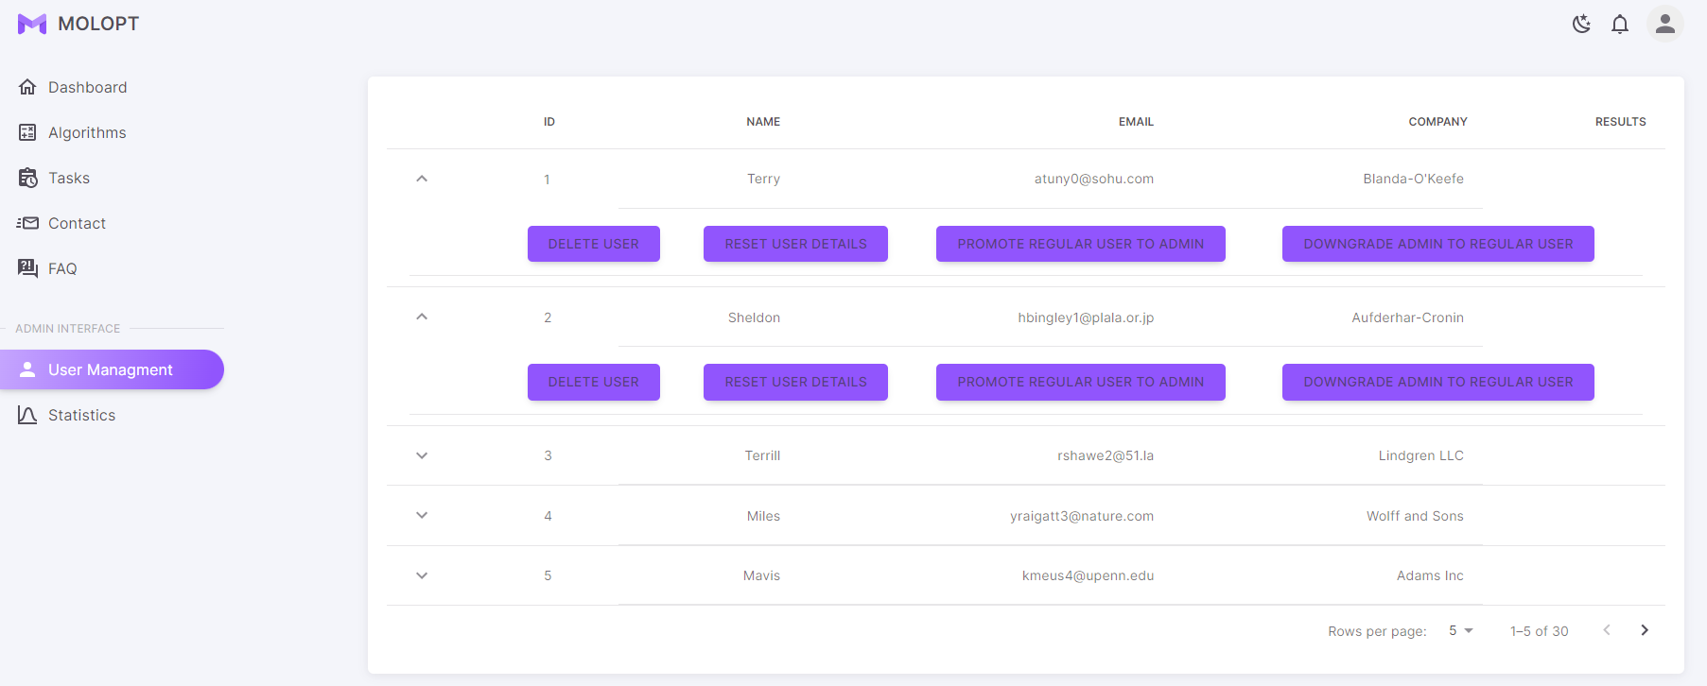

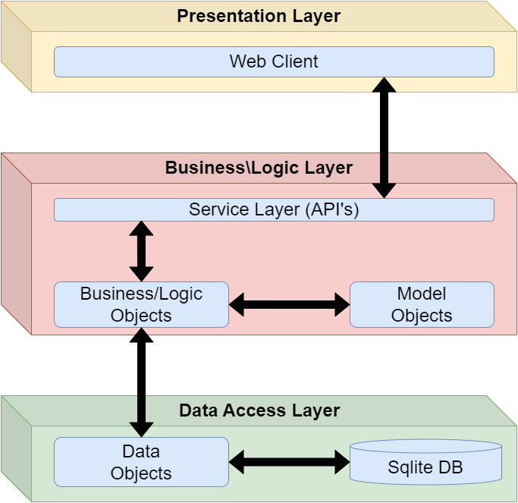
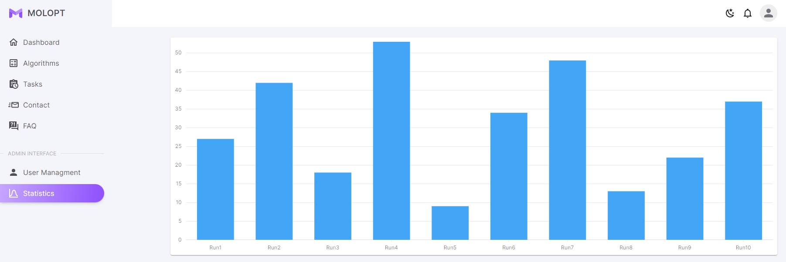


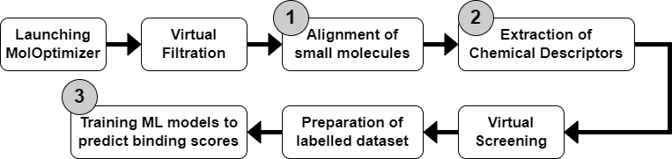
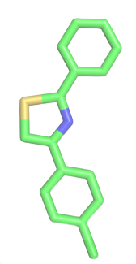







373-1-4401 373-1-4402
הפקולטה למדעי הטבע הפקולטה למדעי ההנדסה
התוכנית להנדסת תוכנה
MolOptimizer
Amit Peled, Daniel Piro, Shahar Alon & Nofar Rozenberg
Advisors: Prof. Kobi Gal, Dr. Niv Gilboa, Prof. Robert Moskovitch, Yuval Moskovitch, Ehud Sivan
Abstract
Features & Screenshots
This project is a software engineering project which created as part of the Ben Gurion University (BGU) software engineering program.
For this project, we assembled with Samuel Viswas and Dr. Barak Akabayov from the BGU Chemistry department to create an amazing global molecules optimizer web-application which called “MolOptimizer” (MolOpt).
MolOpt was Developed at Akabayov Research Laboratories (at BGU), Under the supervision of Dr. Barak Akabayov.
The main purpose of MolOpt and the main reason why it was developed, is to be used by researchers working in the field of small fragment-based inhibitors and is intended to be helpful in optimization of ligand databases.
Our Project
At the beginning, MolOpt was a basic flask-based web package which can be used for Alignment of large ligand datasets, extracting large volume of Chemical Descriptors and training Machine Learning models to predict binding scores, which only ran locally on the labs computers.
Our work included:
Keeping & Optimizing the Alignment, Feature Extractions & ML Algorithm Runnings.
Converting MolOpt to a global and user-friendly web-application.
Updating the old flask application to a modern and new Material UI application.
Adding users’ management & algorithm runs’ management.
System Architecture
Flow
Technologies
Project Logo

